Slide 1
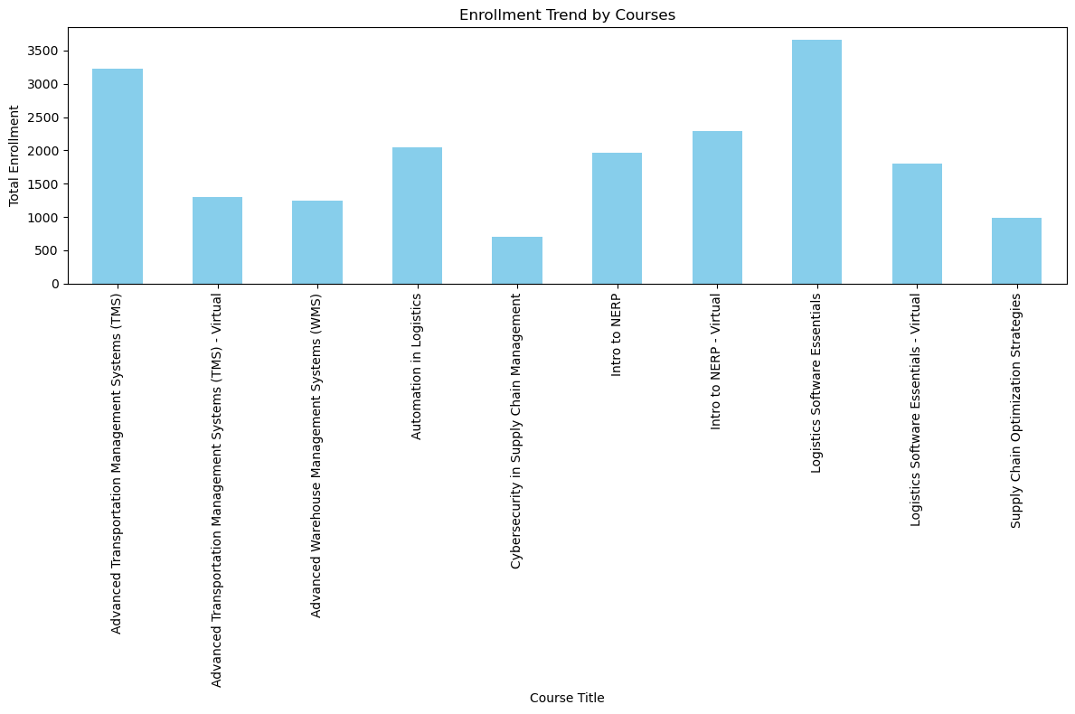
Enrollment Trends by Course
mean | 1924.20
std | 950.04
min | 703.00
median | 1887.50
max | 3663.00

Slide 2
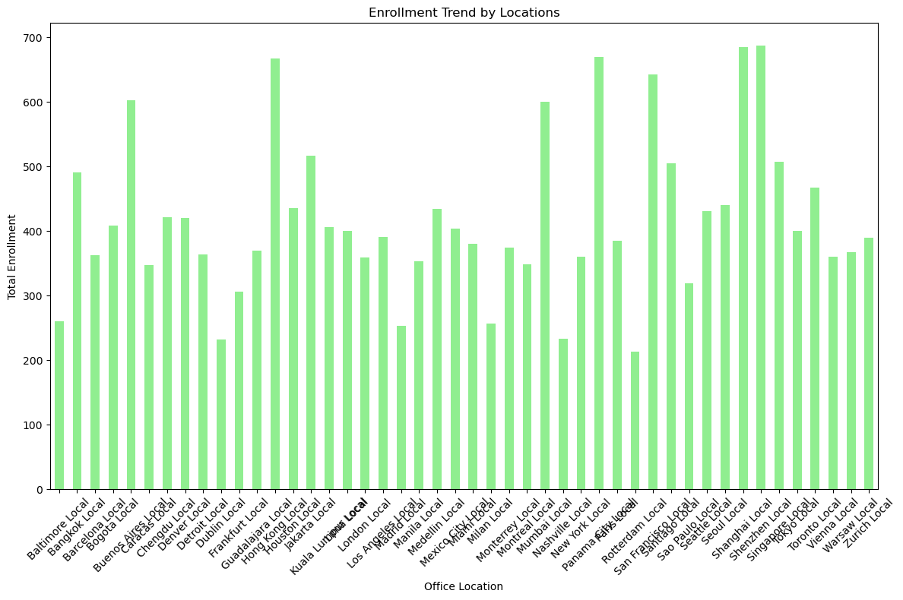
Enrollment Trends by Location
mean | 418.30
std | 122.45
min | 214.00
median | 395.50
max | 688.00

Slide 3
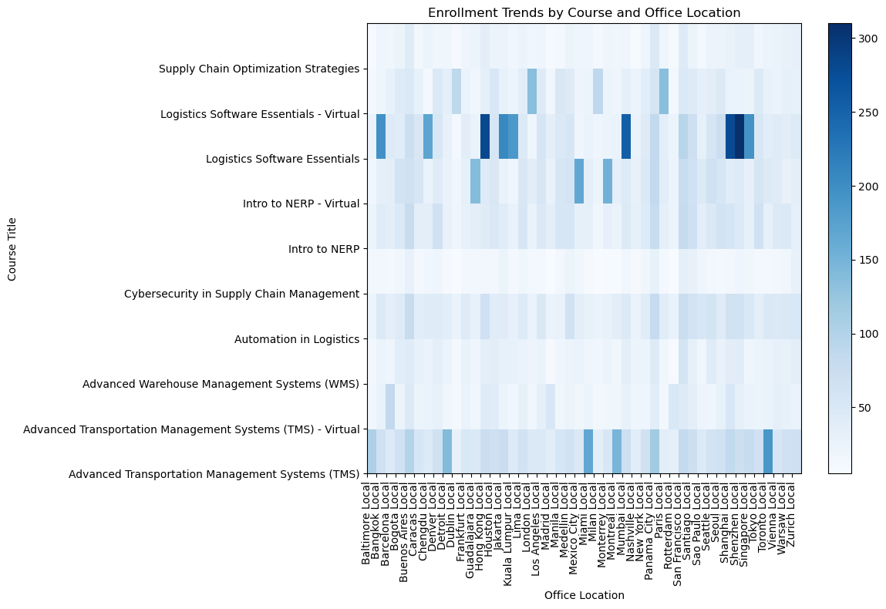
Comparison of Enrollment Across Locations and Courses

